Slide 1
Classification of Cancer by Gene Expression
Source:
“Molecular Classification of Cancer: Class Discovery and Class Prediction by Gene Expression Monitoring” by Golub et al (1999)
Importance:
Choosing therapy that is effective and not toxic
No single test is currently sufficient to establish diagnosis
Systematic and unbiased approach
About cancer:
Acute myeloid leukemia (AML)
Acute lymphoblastic leukemia (ALL)
Incidence: 15 cases per 100,000 persons
Treatment cost: $51 000 per case
Question:
Can cancer type be distinguished based on gene expression?
Dataset:
Training data: 38 patients
Test data: 34 patients
Cancer type: AML or ALL
7129 different genes from microarray data
Notes:
Dataset found on Kaggle
Classify patients with acute myeloid leukemia (AML) and acute lymphoblastic leukemia (ALL)
measurements corresponding to ALL and AML samples from Bone Marrow and Peripheral Blood
DNA microarray
Training: 38 patients
Test: 34 patients
7129 different genes
systematic and unbiased approach
Although the distinction between AML and ALL has been well established, no single test is currently sufficient to establish the diagnosis
4,527 – number of cases of leukemia diagnosed in 2020 in Australia
Leukemias are the 8th most commonly diagnosed cancer in Australia (2016)
2020 - estimated age-standardised incidence rate will be 15 cases per 100,000 persons
2018 – estimated age-standardised mortality rate 6.2 deaths per 100,000 persons
https://www.canceraustralia.gov.au/affected-cancer/cancer-types/leukaemia/leukaemia-australia-statistics
2012-2016 – chance of surviving at least 5 years is 63%
Leukaemia was the most expensive cancer in Australia in 2000-01 in terms of lifetime treatment costs per case, according to figures released today by the Australian Institute of Health and Welfare (AIHW). The estimated treatment cost for leukaemia was approximately $51,000 per case. https://www.aihw.gov.au/news-media/media-releases/2005/may-1/leukaemia-the-most-expensive-cancer-per-case

Slide 2
Classification of Cancer by Gene Expression
Avani Bhojwani

Slide 3
Business Question
Can cancer type be distinguished based on gene expression?
Acute myeloid leukemia (AML)
Acute lymphoblastic leukemia (ALL)
Source:
“Molecular Classification of Cancer: Class Discovery and Class Prediction by Gene Expression Monitoring” by Golub et al (1999)

Slide 4
Importance
Choosing therapy that is effective and not toxic
No single test is currently sufficient to establish diagnosis
Systematic and unbiased approach
Cases of leukemia diagnosed in 2020: 4,527
Incidence: 15 cases per 100,000 persons
Leukemia was the most expensive cancer to treat in Australia in 2000-01
Treatment cost: $51 000 per case
Notes:
Classification of cancer are central to advances in cancer treatment. We need to target specific therapies to distinct tumour types to maximise efficacy and minimise toxicity (side effects).
Although the distinction between AML and ALL has been well established, no single test is currently sufficient to establish the diagnosis. Rather, 4 tests are used in combination.
This can involve looking at cell appearance under the microscope. But this has serious limitations. Tumors with similar appearance can show different responses to therapy. It’s likely that these tumours needed to be subclassified based on other markers (such as molecular/genetic markers).
No generic/general approach to cancer classification, independent of previous biological knowledge.
Leukemias are the 8th most commonly diagnosed cancer in Australia (2016)
2020 - estimated age-standardised incidence rate will be 15 cases per 100,000 persons
4,527 – number of cases of leukemia diagnosed in 2020 in Australia
2018 – estimated age-standardised mortality rate 6.2 deaths per 100,000 persons
2012-2016 – chance of surviving at least 5 years is 63%
Treatment cost: $51 000 per case
Leukaemia was the most expensive cancer in Australia in 2000-01 in terms of lifetime treatment costs per case, according to figures released today by the Australian Institute of Health and Welfare (AIHW). The estimated treatment cost for leukaemia was approximately $51,000 per case.
https://www.canceraustralia.gov.au/affected-cancer/cancer-types/leukaemia/leukaemia-australia-statistics
https://www.aihw.gov.au/news-media/media-releases/2005/may-1/leukaemia-the-most-expensive-cancer-per-case

Slide 5
Data Overview
measurements corresponding to ALL and AML samples from Bone Marrow and Blood
Training: 38 patients
27 patients with ALL
11 patients with AML
Test: 34 patients
7129 different genes
Notes:
measurements corresponding to ALL and AML samples from Bone Marrow and Peripheral Blood
DNA microarray
Training: 38 patients
Test: 34 patients
7129 different genes

Slide 6
Data Pipeline
Define
Objectives
Prepare
Wrangle
Analyse
Visualise
Deliver
Model
Data sources
Strategy
Clean
Profile
Munge
Predict
Revise
Evaluate
Summarise
Advise / Build
Deploy
Exploratory Data Analysis

Slide 7
Exploratory Data Analysis
Top 10 genes from correlation:
Number | Gene | Correlation
1 | Leukotriene C4 synthase (LTC4S) gene | 0.83
2 | Zyxin | 0.82
3 | FAH Fumarylacetoacetate | 0.81
4 | LYN V-yes-1 Yamaguchi sarcoma viral related oncogene homolog | 0.78
5 | LEPR Leptin receptor | 0.78
6 | CD33 antigen (differentiation antigen) | 0.77
7 | Liver mRNA for interferon-gamma inducing factor(IGIF) | 0.76
8 | PRG1 Proteoglycan 1; secretory granule | 0.75
9 | GB DEF = Homeodomain protein HoxA9 mRNA | 0.75
10 | DF D component of complement (adipsin) | 0.74

Slide 8
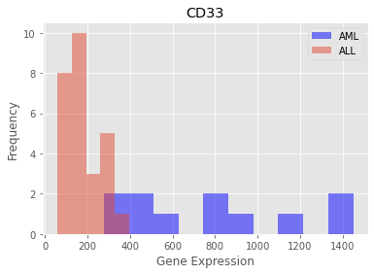
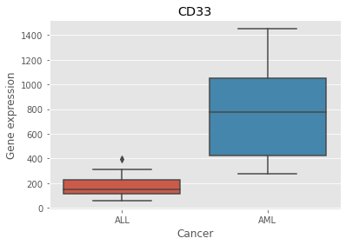
Exploratory Data Analysis

Slide 9
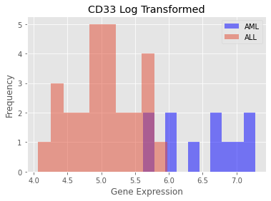
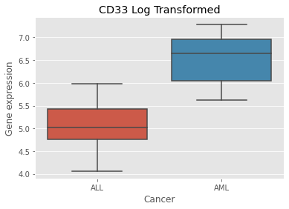
Exploratory Data Analysis

Slide 10
Hypothesis test
Question: Is there a difference in CD33 expression between AML and ALL?
H0: no difference in CD33 expression between AML and ALL
H1: there is a difference in CD33 expression between the two cancers
Significance level: 5%
P value from t-test = 1.90e-09
Conclusion: Reject the null hypothesis. There is a difference in CD33 expression between AML and ALL.
Notes:
CD11c, CD33, MB-1 encode cell surface proteins for which monoclonal antibodies have been demonstrated to be useful in distinguishing lymphoid from myeloid lineage cells.
AML: leptin receptor, zyxin gene

Slide 11
Next steps
Define
Objectives
Prepare
Wrangle
Analyse
Model
Data sources
Strategy
Clean
Profile
Munge
Predict
Revise
Evaluate
Deliver
Visualise
Summarise
Advise / Build
Deploy
Create a model on using a small subset of genes
Exploratory Data Analysis

